Slide 1
Project HR and Communications Management
LECTURE IV

Slide 2
Project HRM
Project HRM include the processes that organize, manage and lead the project team.
The project team is comprised of the people with assigned roles and responsibilities for completing the project.
Project team members may have varied skill sets, may be assigned full or part time, and may be added or removed from the team as the project progresses.
Project team members may also be referred as “project staff”.
Although specific roles and responsibilities for project team members are assigned, the involvement of all team members in project planning and decision making is beneficial.

Slide 3
Project HRM
Project HRM should consider and plan for the availability of or competition of scarce resources.
Team members can be from inside and outside the organization.
Other projects may be competing for HR with same skill set.
These factors can greatly affect project costs, risks schedules, and quality .

Slide 4
Plan HR Management
Acquire Project Team
Develop Project Team
Manage Project Team
Project HRM

Slide 5
Project HRM Overview
The process of identifying and documenting project roles, responsibilities, required skills, reporting relationships, and creating a staffing management plan.
Plan HRM
The process of confirming human resource availability and obtaining the team necessary to complete project activities.
Acquire Project Team
Develop Project Team
The process of improving competencies, team member interaction and overall team environment to enhance project performance.
Manage Project Team
The process of tracking team member performance , providing feedback, resolving issues, and managing changes to optimize project performance.

Slide 6
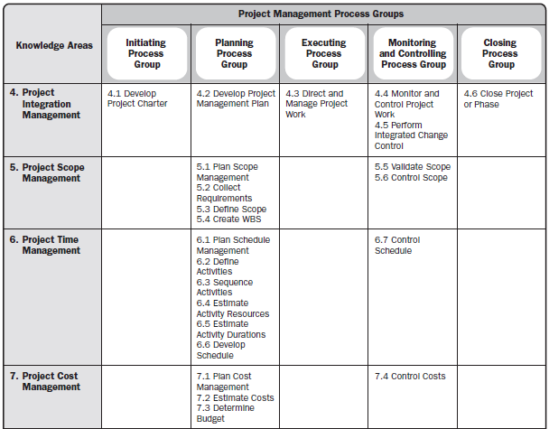

Slide 7
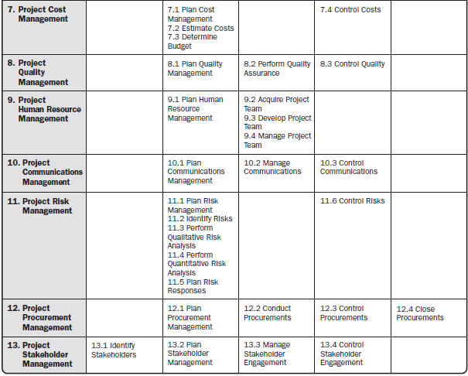

Slide 8
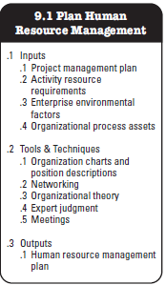
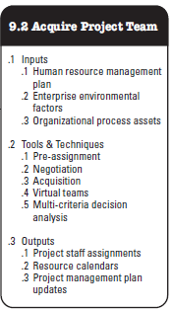
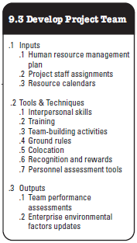
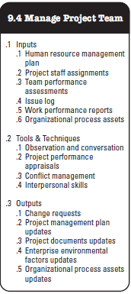
Project Human Resource Management Overview

Slide 9
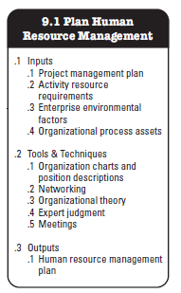
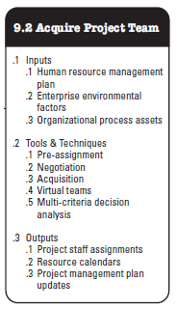
Project Human Resource Management Overview

Slide 10
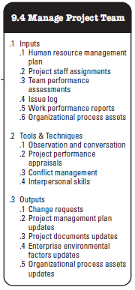
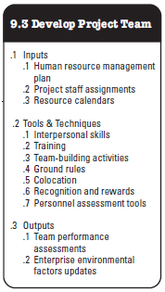
Project Human Resource Management Overview

Slide 11
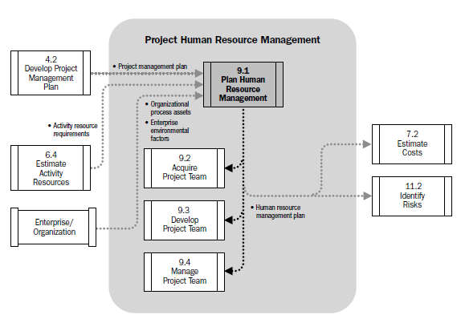
Human Resource Management Data Flow Diagram

Slide 12
Project Management Plan
Project Management Plan is the process of defining, preparing and coordinating all subsidiary plans and integrating them into a comprehensive project management plan. The key benefit of this process is a central document that defines the basis of all project work.

Slide 13
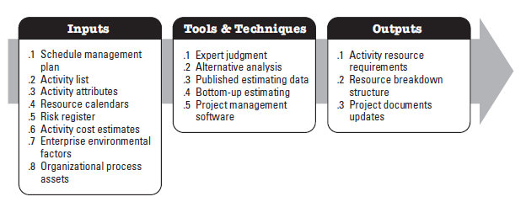
Activity Resources Requirements
This process identifies the type, quantity and characteristics of resources required to complete the activity which allows most accurate cost and duration estimates. The inputs, tools and techniques and outputs for this process are;

Slide 14
Organizational Process Assets
. The organizational process assets that can influence the plan human resources management process include, but are not limited to:
Organizational standard processes, policies, and role descriptions:
Templates for organizational charts and position descriptions:
Lessons learned on organizational structures that have worked in previous
Escalation procedures for handling issues within the team and within the performing organization.

Slide 15
Enterprise Environmental Factors
The Enterprise Environmental factors that can influence the Plan Human Resources Management process include, but are not limited to:
Organizational culture and structure.
Existing human resources.
Geographical dispersion of team members.
Personnel administration policies, and
Marketplace conditions.

Slide 16
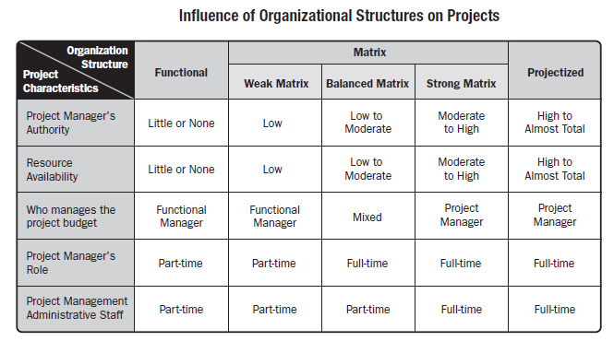
Organizational Structures

Slide 17
Work Breakdown Structure (WBS)
Breakdown of project deliverables. How project deliverables are broken down into work packages provide a way of showing high-level areas of responsibility
Organizational Breakdown Structure (OBS)
OBS is arranged according to an organization's existing departments, units or teams with the project activities or work packages listed under each department.
Hierarchical list of resources related by category and resource type that is used to facilitate planning and controlling of project work. Each descending level represents an increasingly detailed description of the resource until small enough to be used in conjunction with WBS to allow the work to be planned, monitored and controlled.
Resource Breakdown Structure (RBS)
It may contain resource categories other than human resources

Slide 18
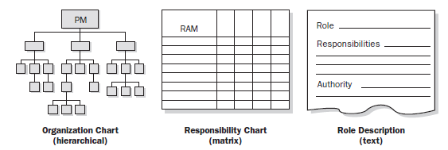
Organization Chart & Position Descriptions
The objective is to ensure that each work package has an unambiguous owner and that all team members have a clear understanding of their roles & responsibilities

Slide 19
Organization Chart & Position Descriptions

Slide 20
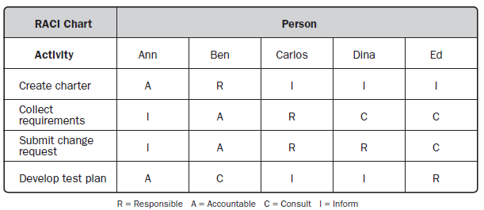
Organization Chart & Position Descriptions
Responsibility Assignment Matrix (RAM)
RAM is a grid that shows the project resources assigned to each work package. It links activities to resources in order to ensure that all work components are assigned to an individual or team

Slide 21
Organization Chart & Position Descriptions
Another variant can be LRC (Linear Responsibility Chart)
It focuses more on naming who is responsible for specified work units at the lower levels of all levels in WBS. As compare to RACI, it shows more of a degree of involvement.

Slide 22
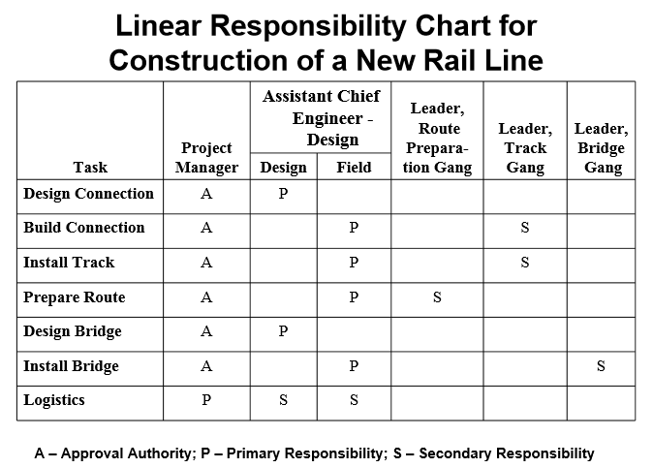
Organization Chart & Position Descriptions

Slide 23
Organization Chart & Position Descriptions
Resource Histogram is a tool that shows number of resources required or assigned over time to a project .
The vertical bars represent the number of people needed in each skill category and by stacking the columns , the total number of resources required for each period can be represented.
This is a handy format to show various stakeholder groups resource views for the project
It can be used to compute the capacity shortages from planned versus available resources.

Slide 24
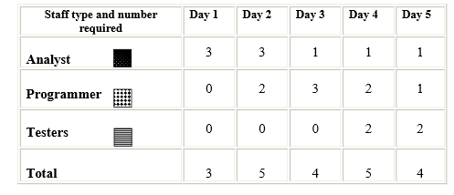
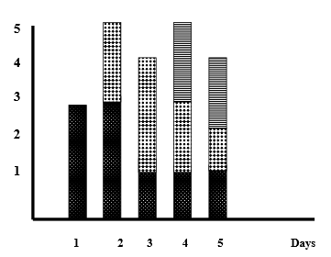
Organization Chart & Position Descriptions

Slide 25
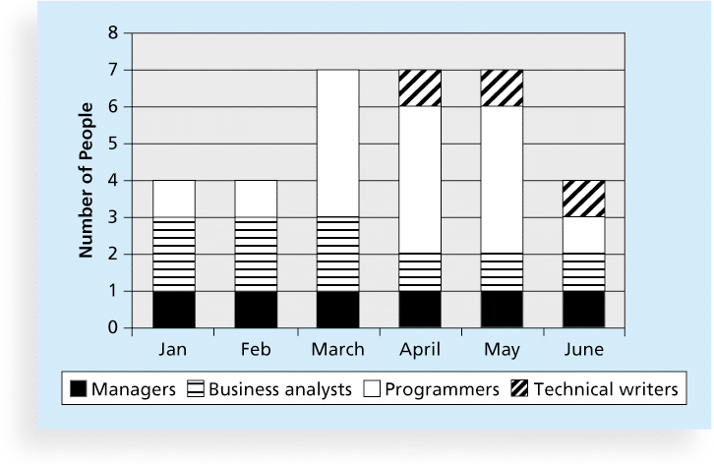
Sample Resource Histogram

Slide 26
A Simple Gantt Chart
Time
J F M A M J J A S
Design
Prototype
Test
Revise
Production

Slide 27
Organizational Theory
Maslow’s Hierarchy of Need
Theories of Motivation
Herzberg’s Motivation – Hygiene Theory
McClelland's Need Theory
McGregor’s Theory “X” and “Y”

Slide 28
Organizational Theory
It provides information regarding the way in which people, teams and organizational units behave.
It’s effective use can shorten the amount of time, cost and effort needed to create the ‘Plan HRM process outputs and improve planning efficiency’.
It is paramount to recognize that different Organizational Structures have different individual response, individual performance and personal relationship characteristics.
Applicable organizational theories may recommend exercising a flexible leadership style that adapts to the changes in a team’s maturity level throughout the project life-cycle.

Slide 29
Expert Judgment
List the preliminary requirements for the required skills.
Assess the roles required for the project based on standardized role descriptions within the organization.
Determine the preliminary effort level and number of resources needed to meet project objectives.
Determine reporting relationships needed based on the organizational culture.
Provide guidelines o lead time required for staffing, based on lessons learned and market conditions.
Identify risks associated with staff acquisition, retention and release plans.
Identify and recommend programs for complying with applicable government and union contracts.

Slide 30
Break

